Slide 1
Basic Internship@Clevered AI App/ Project Name
App User Manual
Author:Hephzibah B

Slide 2
Table of Contents
Acknowledgments About Me About my internship with clevered

Slide 3
Acknowledgements
To Snap To my teacher To my friends About the app How to use Contact Information

Slide 4
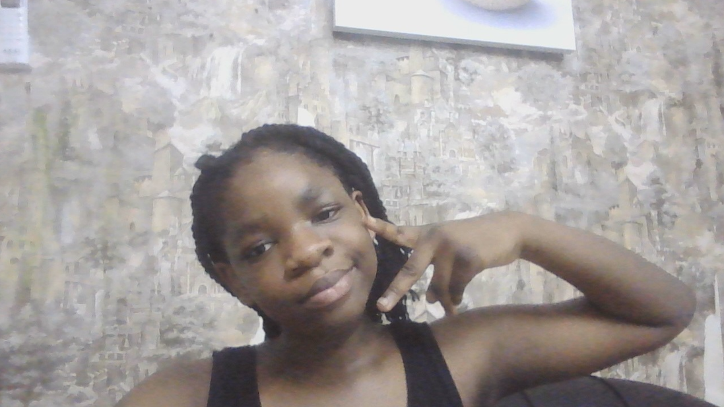
About Me..
Student’s Photograph
Hello my name is Hephzibah (hepz for short) and I am 10 years old+I love to dance

Slide 5
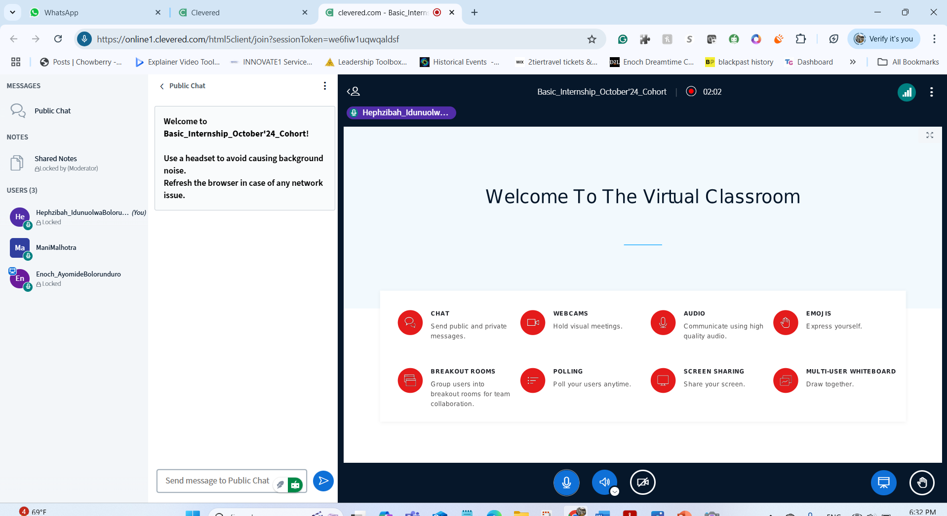
About My Internship with Clevered..
Any photographs from sessions etc.
I loved everything about it Badges Earned:rockstar badge for Attentiveness
Rockstar Badge for project Completion

Slide 6
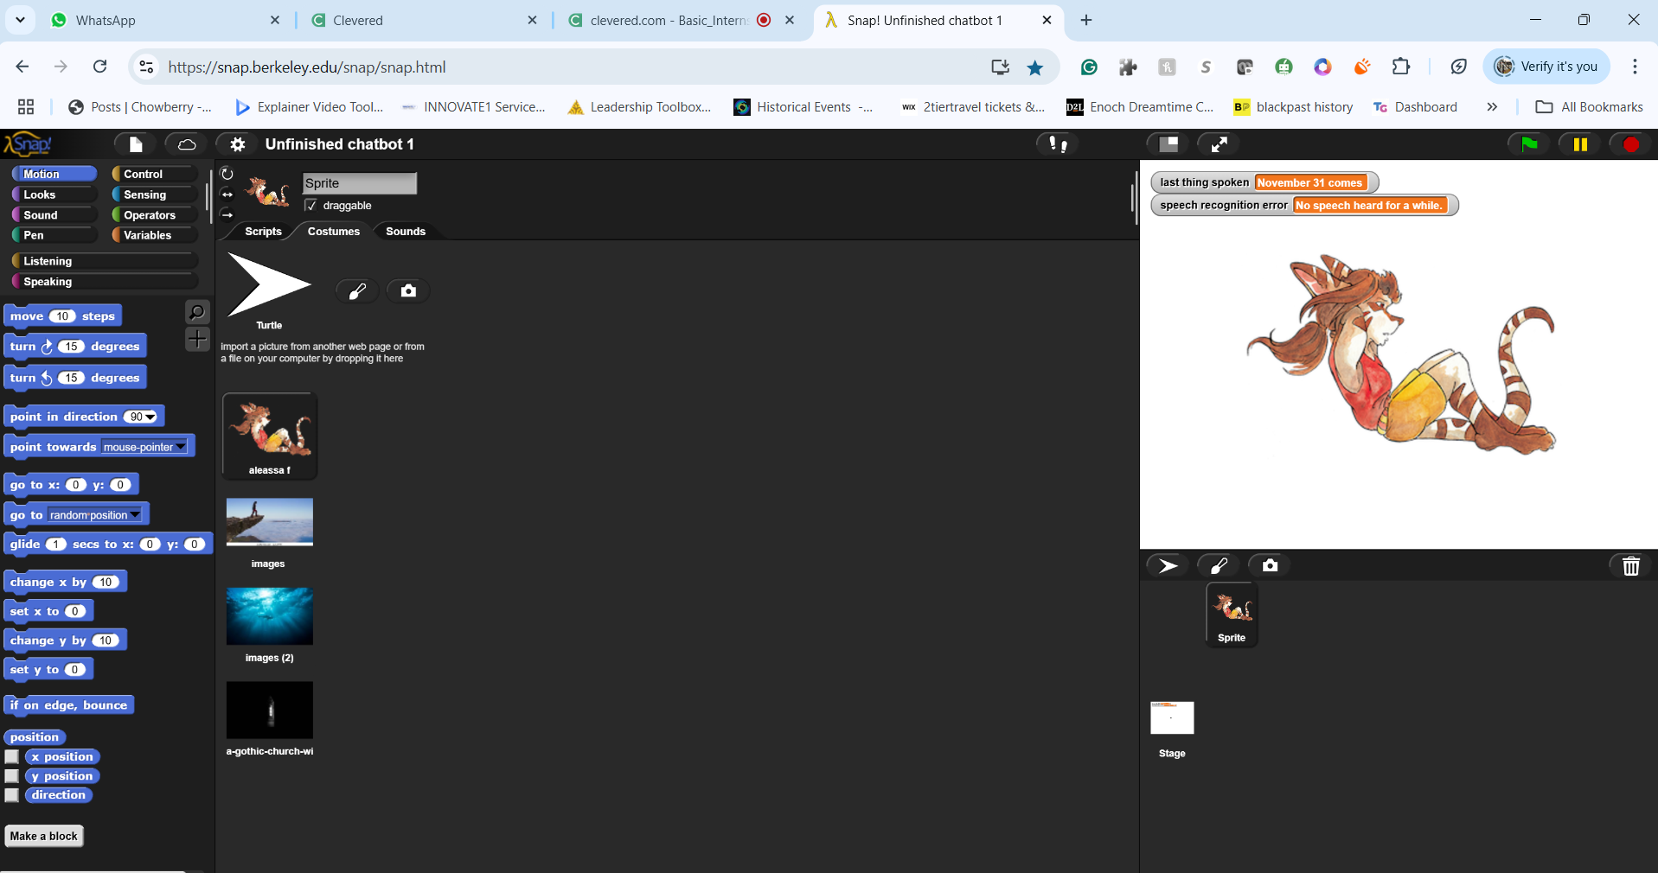
About App..
App’s Main Menu
I choose a chatbot because it provides a unique opportunity for interaction, especially when feelings of loneliness arise. In moments when you may not have someone physically present to talk to, the chatbot serves as a comforting alternative. It allows you to engage in conversation and express your thoughts and feelings without judgment. This interaction can help to ease the loneliness and provide a sense of connection, even if it is with a virtual assistant. Chatbots are available at any time, making them a reliable option for those seeking companionship or someone to talk to, which can be particularly valuable during difficult times. By using the chatbot, you can find some relief from the isolation that might come with being alone, making it an important tool for emotional support.

Slide 7
How do I use the App?

Slide 8
Option Name
(This will be repeated for each option of the App)
Screenshot/ Pic of each option/screen of the App
Steps to use the same
Any special considerations/ dependencies/risks while using the option

Slide 9
Contact Person
Number:+974 5560 8319 Email address:princesshephzibah1234@gmail.com

Slide 10
Thank you!

